Slide 1
Creating Career Day Events Your Students Will Never Forget
Karen Powell – M.ED, CSC, LPC
281-435-0877 (cell)
Scott Sterrantino
972-740-9800 (cell)

Slide 2
This workshop covers:
Importance of College/Career Readiness Activities
How to Organize a Successful Career Day
How to Schedule Students into Career Day Sessions
Whole Class vs. Student Choice
hyperSuite (Career Day Scheduling Software) Demonstration
Other college/career activities (if time allows)

Slide 3
House Bill 5
http://www.capitol.state.tx.us/tlodocs/83R/billtext/pdf/HB00005F.pdf
Section 30(a); Sections 33.007(a) and (b), Education Code, are amended to read as follows:

Slide 4
House Bill 5
(a) Each school counselor at an elementary, middle, or junior high school, including an open-enrollment charter school offering those grades, shall advise students and their parents or guardians regarding the importance of postsecondary education, coursework designed to prepare students for postsecondary education, and financial aid availability and requirements.

Slide 5
ASCA Mindsets & Behaviors for Student Success
K-12 College and Career Readiness for Every Student
https://www.schoolcounselor.org/asca/media/asca/home/MindsetsBehaviors.pdf

Slide 6
ASCA Mindsets & Behaviors for Student Success
Organized by:
Domains
Academic Development
Career Development
Social/Emotional Development
Standards (Mindset Standards & Behavior Standards)
Six Mindset Standards
M 4 Understanding that post-secondary education & life-long learning are necessary for long-term career success.
M 6 Positive attitude towards work and learning.
Grade Level Competencies

Slide 7
ASCA Ethical Standards for School Counselors
New Verbiage Added in 2016 Revision
A.4 – Academic, Career & Social/Emotional Plans
A.4.a (new) – “Collaborate with administration, teachers, staff and decision makers to create a culture of postsecondary readiness.”

Slide 8
ASCA Ethical Standards for School Counselors
A.4.b - “Provide & advocate for the individual students PK-Postsecondary college and career awareness, exploration and postsecondary planning and decision making, which supports the students’ right to choose from the wide array of options when students complete secondary education.”

Slide 9
ASCA Ethical Standards for School Counselors
A.4.c (new) – “Identify gaps in college and career access and the implications of such data for addressing both intentional and unintentional biases related to college and career counseling.”

Slide 10
ASCA Ethical Standards for School Counselors
A.4.d - “Provide opportunities for all students to develop the mindsets and behaviors necessary to learn work-related skills, resilience, perseverance, an understanding of lifelong learning as a part of long-term career success, a positive attitude toward learning and a strong work ethic.”

Slide 11
Contact Colleges for Free Stuff
Promote College & Career Readiness by displaying college pennants and posters around your school
Elementary students love to get free “stuff”
Start by going to various college websites and email admissions. Prepare your email in advance so you can copy & paste your request. Sometimes the website will have a form that you fill out for promotional materials.

Slide 12
Contact Colleges for Free Stuff
Ask for posters, pencils, t-shirts, stickers, tote bags, and other trinkets.
Send thank you emails when representatives contact you back or if you get a super shipment of stuff.
Solicit help from your committee or paraprofessionals to sort through the trinkets. The goal is to get enough for each student who is participating in career day to get at least one thing.
See Handout 1 for sample email

Slide 13
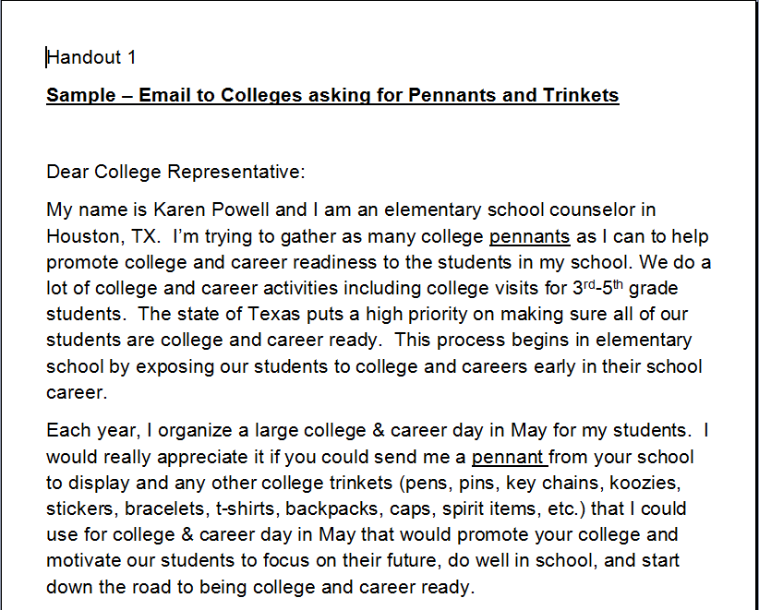

Slide 14
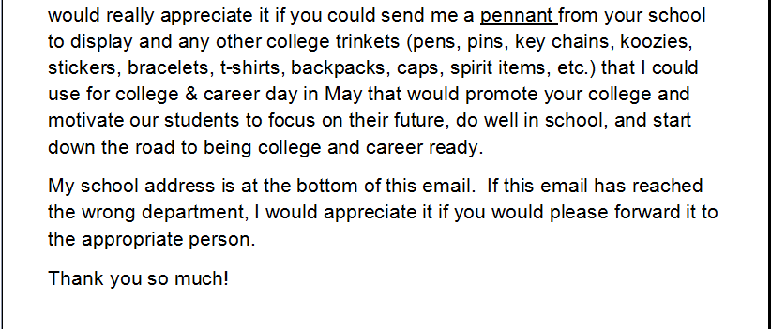

Slide 15
Contact Colleges for Free Stuff
Keep a log of the colleges you have contacted and what they send to you so you don’t inadvertently duplicate your request.
Notate the email address that the request was sent to.
The following year, email other colleges to get more pennants.
Email the same colleges for more trinkets, if you wish.

Slide 17
District Resources
Attend your district’s high school college/military fairs. These are usually held in the fall. You can get free stuff and pennants too.
Check with district’s CCR department for ideas and resources.

Slide 18
What Do You Do With All the Free Stuff?
Display your banners, posters, and pennants around the school or in a specific area.

Slide 19
What Do You Do With All the Free Stuff?
Give each teacher a baggie/basket containing the trinkets and have the teachers pass them out after the career day sessions are over.
Consider holding a drawing to give away larger items such as tote bags, sports items, and t-shirts. You can name the winners on the morning announcements and have them come to the office to get their item.

Slide 20
What Do You Do With All the Free Stuff?
Most colleges send tons of pamphlets and other printed materials. Use these for:
College Night/Fair
Use some for College Spotlight bulletin boards.

Slide 21
Career Day Styles
Speakers rotate to individual classrooms.
Homeroom classes rotate as a whole to individual speaker rooms.
Students rotate to various speakers based on their interests and pre-selected choices.

Slide 22
Planning for Career Day
Pick a date.
Consider forming a Career Day Committee with a representative from each grade level.
Decide on the Career Day Style you will use.

Slide 23
Planning for Career Day
Decide on the schedule.
Will you have a keynote speaker session that all students attend together?
How many sessions will each student attend?
What time will Career Day Start & End?

Slide 24
Planning for Career Day
How long will each session be?
How much time will you need between each session for transition?
Decide how many grade levels will participate and if they will all attend every session or sessions of various lengths.
Will you need to rearrange any lunch/recess or outclass schedules?

Slide 25
Planning for Career Day
Don’t be afraid to start small and build your career day over several years.
Determine how many classrooms will be available to use for presenters. Don’t forget common rooms such as the computer lab, library, etc. that may be available.
Decide how many presenters you need. You cannot have more presenters than you have rooms to put them in.

Slide 27
Planning for Career Day
To know how many presenters you will need, divide the number of students that will attend each session by the number of students you want in each session.
For example: 15-25 students per session is a good number for elementary; secondary can be higher. If you have 3 grade levels (300 students) participating, then you need between 12-20 presenters.

Slide 28
Planning for Career Day
This gives you a target to shoot for.
You don’t want a presenter to end up with 5 students in their session because you have too many presenters or
50 students in a room that holds 25 because you don’t have enough speakers.

Slide 29
Planning for Career Day
Send email invitations to district people you may want to invite to your Career Day (area supervisors, superintendent, community relations department, district photographer, other special guests).
This is good PR for your school.

Slide 30
Ideal Presenters
Love kids (elementary) or teens (middle school & high school)
Use visuals (Power Point, Pictures, Displays, Video Clips, Concrete Objects, etc.) or Interactive Activities with students
Are punctual
Respond to your emails in a timely manner

Slide 31
Ideal Presenters
Are excited about their career and love to share it with others
Bring free stuff from their job (pencils, stickers, etc.) to give to the students. This is an added bonus.
Pictures of ideal Presenters

Slide 32
How Do You Find Presenters?
Think about who you do business with (bank, insurance, doctor, dentist, veterinarian, grocery store, electrician, auto mechanic, etc.)
Think about people you know and what their jobs are (church, clubs, social circles, etc).
Ask your faculty for referrals. Teachers’ spouses can be an excellent resource.

Slide 33
How Do You Find Presenters?
Send a letter home with students asking parents to present their careers. Depending on your school, this may or may not be a good idea because you may end up with 5 financial planners or someone who is a poor presenter. See handout 2
Generally, for elementary, you don’t want duplicate careers unless it is a very popular career or you have an unusually high number of students.

Slide 35
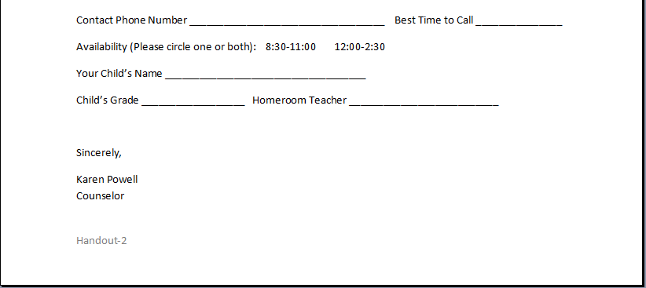

Slide 36
How Do You Find Presenters?
Look through your school district phone book. There are many professional people who work in the district (graphic artists, high school technical education teachers, human resources, athletic department, therapists such as music, physical, speech, occupational).
Contact college admissions or recruiting departments in your area.
Always keep your eyes/ears open for potential presenters.

Slide 37
Contacting Potential Presenters
Write your email: Include basic details such as the date, time, how many times they will be expected to speak, age of students, number of students in each session, etc.
Send email to referrals you have received and to people you know.
Call potential presenters. If they are interested, follow up with an email containing the details.
Keep a color-coded log of your contacts.

Slide 39
Emails to Presenters
Compose an email for:
New Presenters
Returning Presenters
Equipment Requests
Parking Information & Last Minute Reminders
See handouts 3-4 for sample emails

Slide 40
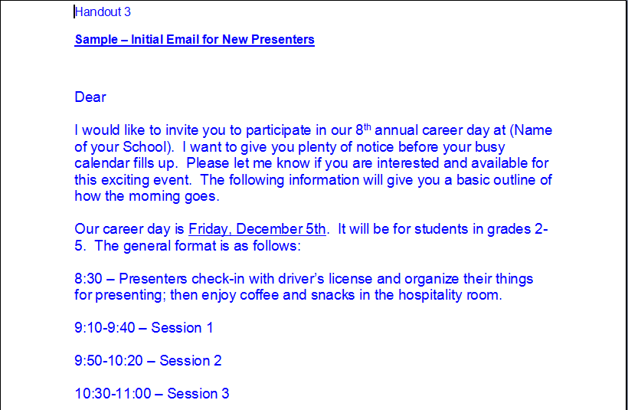

Slide 42
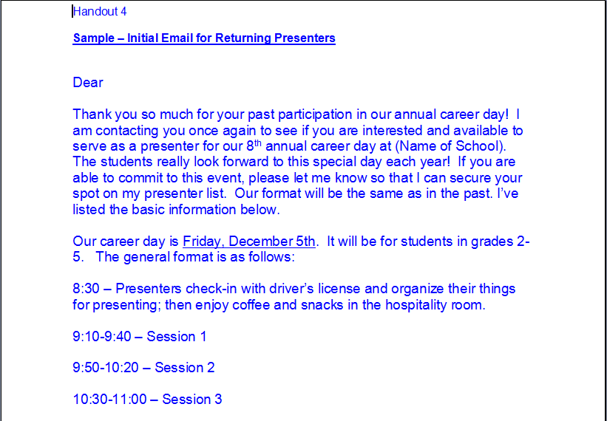

Slide 44
Timeline for Contacting Presenters
Suggest 3 Emails at Strategic Intervals:
Ideally, 3 months prior to the event, make your first contact with presenters, giving them the basic schedule and what is expected of them. Include questions to address during presentation. See handout 5
2. One month prior – email your confirmed presenters asking/verifying equipment needs so that you can plan room assignments. See handout 6

Slide 47
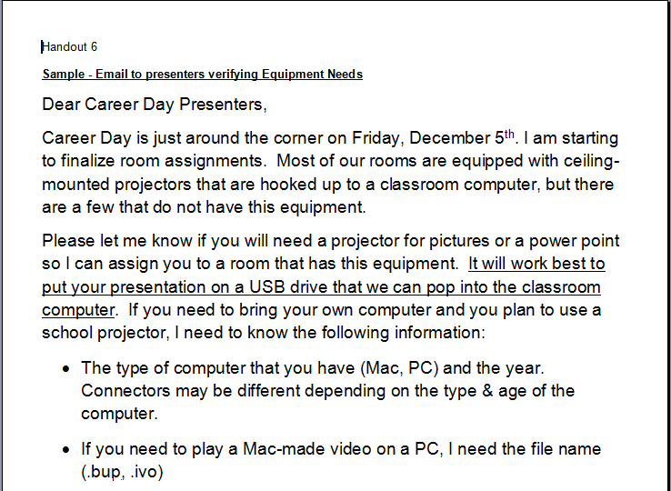

Slide 50
Timeline for Contacting Presenters
3 Days prior to the event – send out parking information with a map and directions on where to park & ask for a cell phone contact.
See handout 7

Slide 51
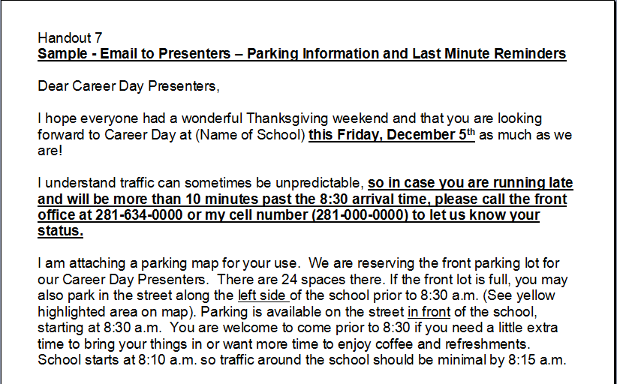

Slide 52
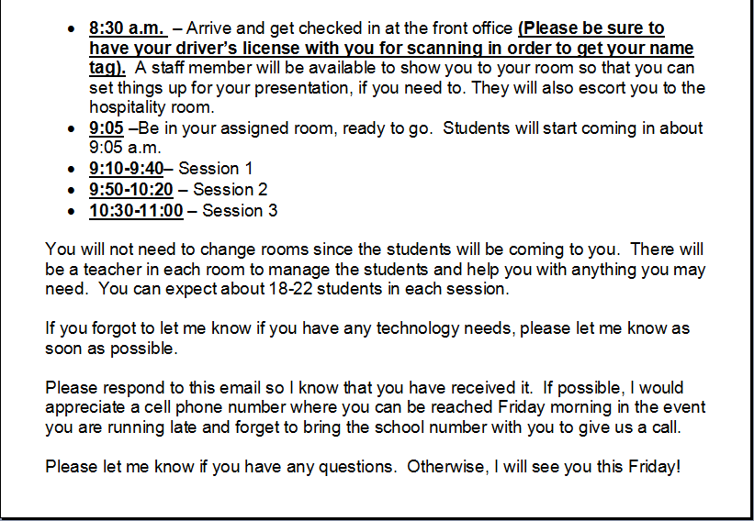

Slide 54
Timeline for Contacting Presenters
Sending emails at these intervals eliminates potential no-show presenters by keeping the event in the forefront of their minds.
It also gives you time to make other arrangements or adjustments to your day if your email has jogged their memory that they can no longer come.

Slide 55
Equipment Needs
Check with each teacher whose room you might use to see what equipment is working.
Include on the checklist:
Projector with working bulb
Computer with Internet is hooked to projector
ELMO
Ability to play a DVD

Slide 56
Equipment Needs
You should check with the teachers at least 6 weeks prior to the event so that if there are equipment problems, there is time to get them fixed.
Remind teachers to let you know if they have any equipment issues after the checklist is filled out.

Slide 58
Career Synopsis
Once you have your presenters committed, write a student-friendly description of each career.
This can be used by the students when they make their choices.

Slide 59
1 | Accounting (Houston Community College) | There are many types of accountants and every company needs accountants. One thing they all have in common is they love math and numbers and are very organized. | Ms. Fenton
2 | Auto Mechanic | Do you love cars? Do you like taking things apart and putting them back together again? A good mechanic will always have a job as long as people keep driving cars! | Mr. Johnson
3 | Chemist | Science can be very exciting! Come and learn how mixing chemicals, doing experiments, and knowing about DNA can help in many different jobs – from solving crimes to finding cures for diseases. | Ms. Russ
4 | Chiropractor | Chiropractors help relieve back, shoulder, and neck pain by using their hands to adjust joints of the body so that patients can move without pain. | Dr. Stacy Anderson
5 | Church Worker/Pastor | Do you enjoy working with people and sharing your beliefs with them in a church setting or visiting people in the hospital or their homes? This career involves working with people of all ages. Men & women both enjoy this career. | Mr. & Mrs. Tucker
6 | Cowboy/Rodeo | Do you like animals, competition, and traveling? If so, you might enjoy a career as a cowboy/cowgirl or traveling with the rodeo. | Mr. Hendrickson
7 | Crime Scene Investigator (CSI) | If you like mysteries, this might be a career you would be interested in. CSIs investigate crime scenes by processing physical & trace evidence, taking photographs and finger prints, matching firearms to crimes and hopefully catching the bad guys. | Mr. Storm
8 | Eye Bank Laboratory (Community Project Coordinator) | Being able to help people have good eyesight after an accident or medical problem can be very rewarding. Learn how science can help people have a better life. | Ms. Pupperton

Slide 60
Hospitality Room
A Hospitality Room is a nice way to show appreciation to presenters.
Helps alleviate coordinator’s stress.
Presenters are more likely to be on time for career day when the hospitality room is opened prior to the first session as opposed to after sessions are over.
Presenters don’t feel that their time is being wasted by being early. They also enjoy meeting and talking with other presenters.

Slide 61
Hospitality Room
Choose one of your larger rooms.
Decorate
Have student council or other school clubs make thank you signs or banners to post in the room.

Slide 62
Hospitality Room
Decide on menu (fruit, yogurt, sweet rolls, kolaches, breakfast tacos, coffee, tea, hot chocolate, juice,water, etc.)
Paper goods
Staff member to be the host/hostess for the room
Leave Hospitality Room open the entire time, if possible so presenters can grab a water or snack between sessions or on their way home, if desired

Slide 63
One Week Prior to Career Day
Send logistics email to staff
See Handout 8
Figure out where you need help on Career Day (monitoring stations, check-in, etc.) and who will help (ESL teachers, Paraprofessionals, A.P., Principal, Math/Reading Specialists, Reading Recovery Teacher, Librarian, Tech Specialists, etc.)

Slide 64
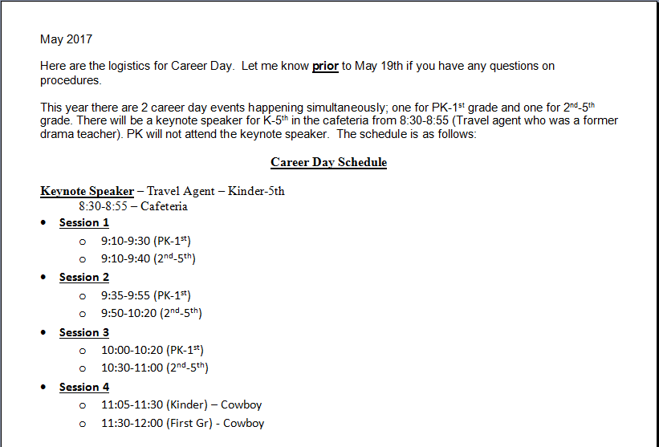

Slide 65
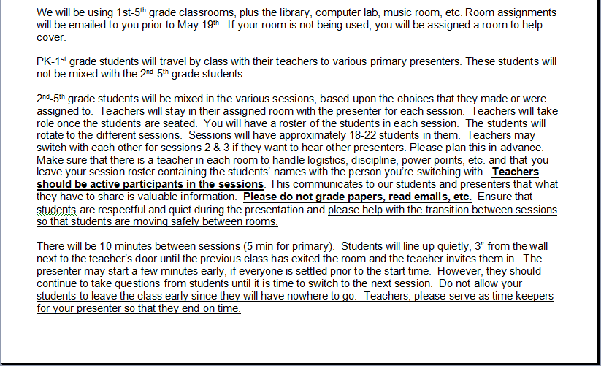

Slide 66
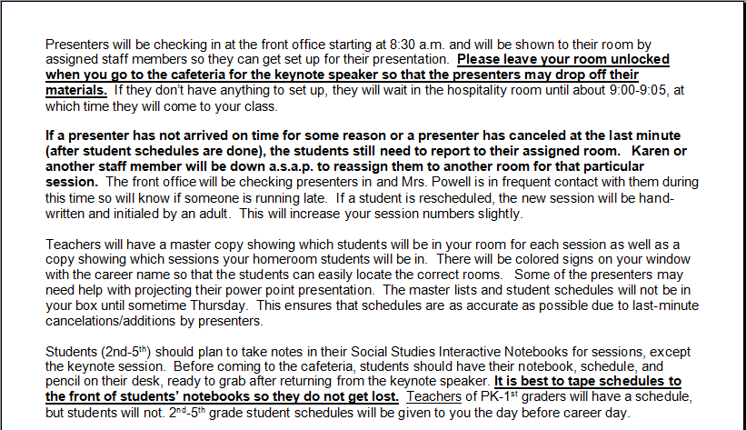

Slide 67
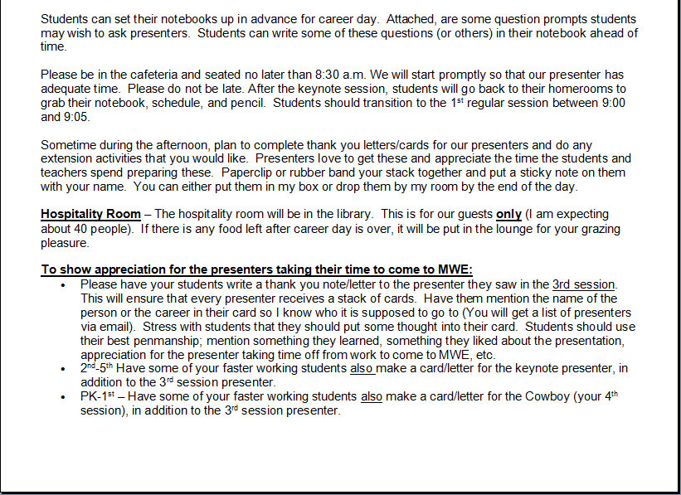

Slide 68
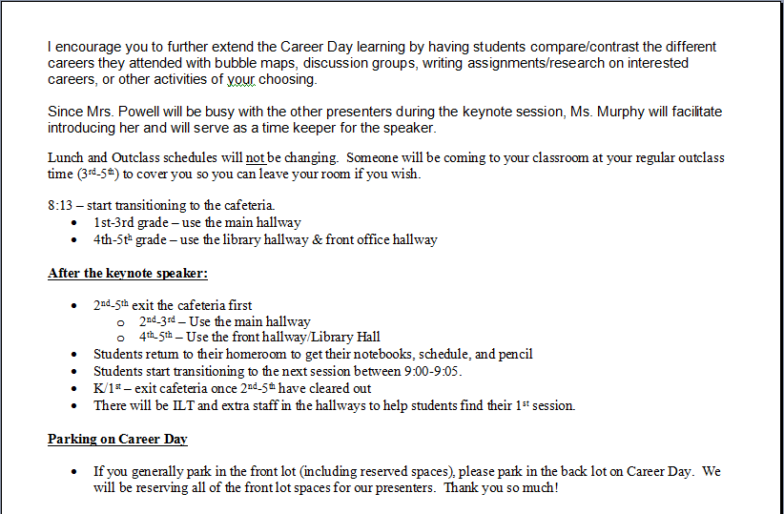

Slide 69
One Week Prior to Career Day
Helpers:
Place them at strategic places in the hallways during transitions to monitor students and help them find rooms, if needed.
Cover common rooms where there are no classroom teachers
Tech support – highly recommended
Staff member - on-call for any other assistance that is needed.

Slide 71
Handouts for Staff Organization
Handout 9 – Career Day Assistance
Handout 10 – Monitor Stations
Handout 11 – Outclass Coverage
Handout 12 – Room Assignments

Slide 72
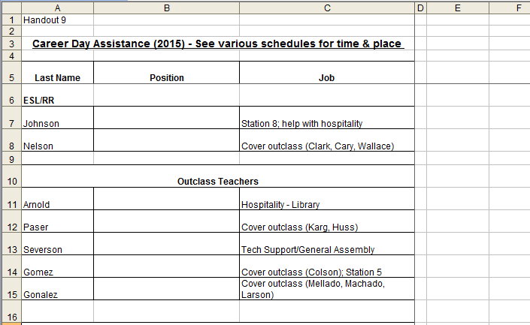

Slide 73
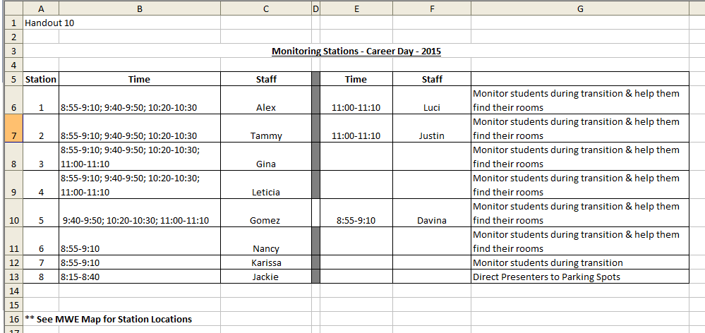

Slide 74
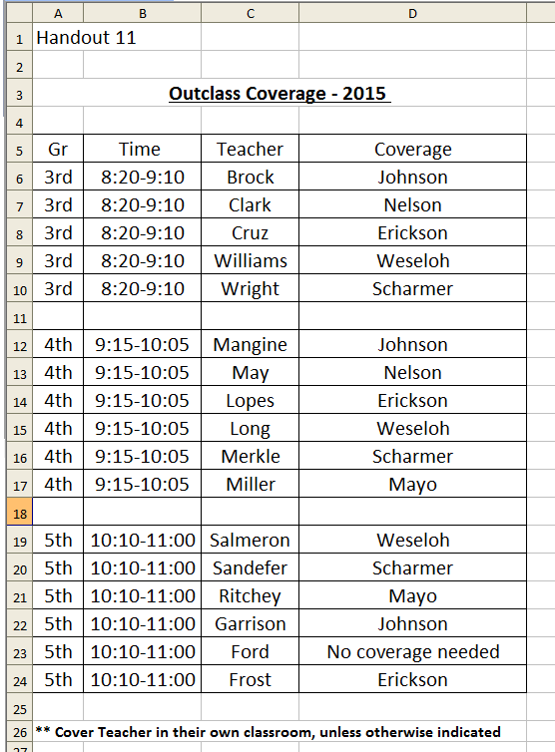

Slide 75
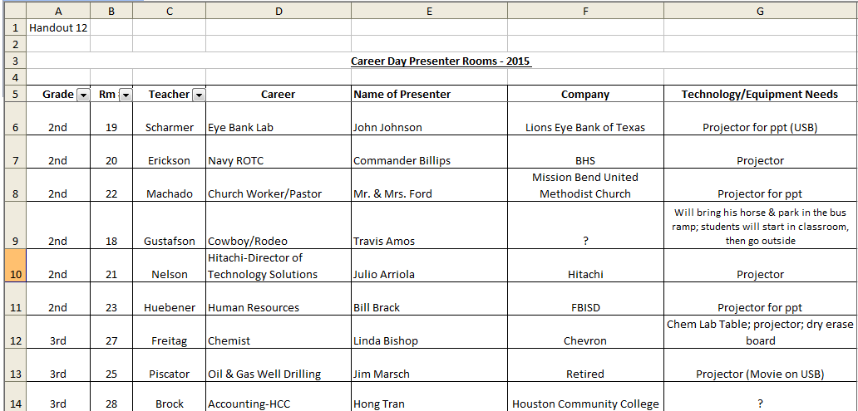

Slide 76
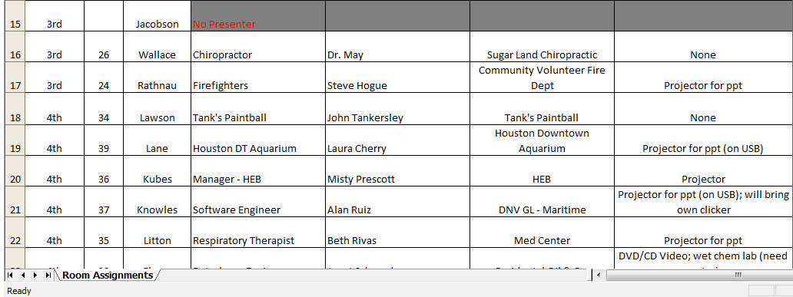

Slide 77
One Week Prior to Career Day
Meet with Student Council Members if you plan on using them.
Make a Welcome Banner to display in the front office.
Make Door Signs on bright colored paper.

Slide 78
One Week Prior to Career Day
Have Parent helpers make Career Day folders for each child with several pieces of paper in them for taking notes.
If using hyperSuite – have students sign-up for career choices either via the computer lab or iPads (make a QR code or add to favorites in advance).

Slide 79
1 or 2 Days Prior to Career Day
Post your Door signs in the same location for each room and high enough so that it is above students’ heads.
Putting signs up early helps create excitement for the upcoming event. It also helps students find their rooms on career day.
Shop for Hospitality Room items & food.

Slide 80
1 Day Prior to Career Day
Give the front office a list of all the presenters and instruct them to check off each presenter as he/she arrives.
Give the front office a copy of the master schedule so if they need to find a student on career day, they can.
Give teachers their master schedule for the presenter they are hosting.

Slide 81
Tape signs to orange cones to direct presenters to parking spots.

Slide 82
1 Day Prior to Career Day
Meet with your student council members (if they are helping) to give them instructions on how to be a host/hostess.
Make sure teachers have received student folders for note-taking.
Deliver student schedules to teachers. Students can staple/tape these to their folders.
Hang Welcome Banner

Slide 83
During Career Day
Stay close to the front office and your cell phone to monitor the arrival of presenters until they have all shown up at your campus.
Greet them as they come in.

Slide 84
During Career Day
If all presenters show up on time – RELAX and enjoy the day.
Pop into each room and observe, take pictures, etc.

Slide 85
During Career Day
If you have a last minute cancelation once schedules are run or a No-Show, implement Plan B.
Plan B - Students still report to assigned room. A staff member meets them there & reassigns students. Write the new room number & career on the student’s schedule and initial.

Slide 86
During Career Day
If time allows, notate on Master List what session the student was reassigned to.

Slide 87
After Career Day
Give teachers not more than 3 days to turn in the thank you notes/letters that students have written to the presenters.
All students pick the presenter they heard last (as opposed to their favorite presenter) to write a note to. This ensures that all presenters get a fair amount of cards/letters.

Slide 88
After Career Day
Write a thank you letter of your own to each presenter to include with students’ cards. If you want the presenter back next year, mention that you hope they will consider returning next year. If you don’t want them back, do not include that comment.
Ask for Feedback from teachers and students and save feedback for tweaking the event next year.
Clean-up, relax, and enjoy the awesome emails you receive from the staff about career day. Then go home early if you can. You will be exhausted.

Slide 89
Scheduling Students with Presenters – Whole Class Method
Whole Class Method
Make a schedule 3-5 days prior to the event and give to teachers.
Assign speakers to whole classes (either the speaker moves or the whole class moves).

Slide 90
Advantages & Disadvantages to Whole Class Method
Advantages
Quick to organize
Disadvantages
Not all students will be interested in the career they were assigned to hear about or they may have heard the presenter in prior years.
Inconvenient for the speaker to move

Slide 91
Scheduling Students with Presenters – Student Choice
Student Choice
Using hyperSuite (School Career Day Software) – Start the student sign-up process 3-5 days prior to the event.
Manual scheduling – you need a lot of time.

Slide 92
Problems with trying to manually schedule student choices.
Very time consuming (at least 50-60 hours of time if you have 400-500 students participating and are proficient with Excel).
If you have a last minute cancelation, the lists have to be adjusted and this creates more hours of work when time is short.
Lots of room for error due to interruptions and students not signing up according to directions.

Slide 93
Using hyperSuite to Schedule Students
hyperSuite takes the frustration out of career day scheduling and takes only a few hours of the coordinator’s time.
hyperSuite can be used for student choice or randomly assigning entire groups of students to various presenters.

Slide 94
Advantages & Disadvantages to the Student Choice Method
Advantages
Students will be more engaged.
Students can learn about careers they are interested in.
Students are more excited
Can use Naviance and hyperSuite together

Slide 95
Advantages & Disadvantages to the Student Choice Method
Disadvantages
Takes a little more planning than whole-class method.
A little bit more time consuming for the coordinator

Slide 96
hyperSuite Demonstration

Slide 97
Other College/Career Activities
College/Military Shirt Day (pick a day each week or alternate with spirit day)
Interactive College Boards
Feature a college each week on announcements.
Parent Information night - invite a college rep to talk about how to pay for college.
Lots of ideas on Pinterest

Slide 99
College Visits
Find a college that will accommodate the entire grade level, if possible.
Secure funding for buses (school funds, fund raisers, Title I funds, grade level budgets, community sponsors, students pay a set fee, etc.).
Pick a date.
Schedule tours of the campus, dorms, recreation center, student center, etc.

Slide 100
College Visits
Reserve space at the student cafeteria (all-you-can-eat buffets are a student favorite).
Collect money in advance for lunch and pay as a large group.
Create a lesson plan for pre/post visit.
Take a virtual tour of the college you will visit.

Slide 101
JA BizTown
Houston

Slide 102
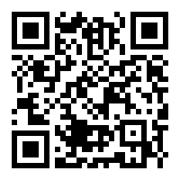
Access the Presentation Materials Using the QR Code
http://www.schoolcareerday.com/TCA/PSCC2018/

